Slide 1
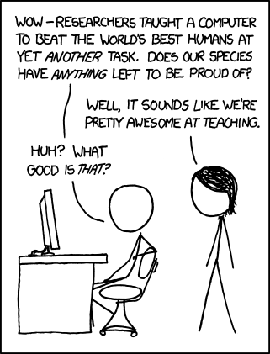
https://xkcd.com/894/

Slide 2
Introduction to Machine Learning
David Kauchak CS 158 – Fall 2023

Slide 3
Introductions
Dr. | Prof | Professor
Dave | Kauchak
Pronouns: he/him/his

Slide 4
Why are you here?
What is Machine Learning?
Why are you taking this course?
What topics would you like to see covered?

Slide 5

Machine Learning is…
Machine learning is a subfield of computer science that evolved from the study of pattern recognition and computational learning theory in artificial intelligence.

Slide 6
Machine Learning is…
Machine learning is programming computers to optimize a performance criterion using example data or past experience.
-- Ethem Alpaydin
The goal of machine learning is to develop methods that can automatically detect patterns in data, and then to use the uncovered patterns to predict future data or other outcomes of interest.
-- Kevin P. Murphy
The field of pattern recognition is concerned with the automatic discovery of regularities in data through the use of computer algorithms and with the use of these regularities to take actions.
-- Christopher M. Bishop

Slide 7
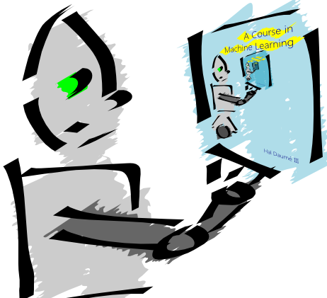
Machine Learning is…
Machine learning is about predicting the future based on the past.
-- Hal Daume III

Slide 8
Machine Learning is…
Machine learning is about predicting the future based on the past.
-- Hal Daume III
past
future
predict
learn
Training
Data
model/
predictor
Testing
Data
model/
predictor

Slide 9
Machine Learning, aka
data mining: data analysis, not prediction, though often involves some shared techniques
inference and/or estimation in statistics
pattern recognition in engineering
signal processing in electrical engineering
induction
optimization

Slide 10
Goals of the course: learn about…
Different machine learning problems
Common techniques/tools used
theoretical understanding
practical implementation
Proper experimentation and evaluation
Dealing with large (huge) data sets
Parallelization frameworks
Programming tools

Slide 11
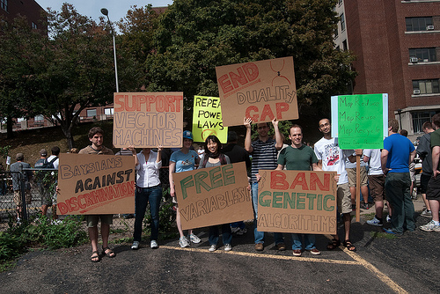
Goals of the course
Be able to laugh at these signs
(or at least know why one might…)

Slide 12
Goals of the course
90s:
early 2000s:
after that:
currently:
neural networks
support vector machines
probabilistic models (aka graphical models)
neural networks, deep learning
Why mention this now?
Notes:
Things change! Next decade it’s going to be something else that’s the “it” model. Goal of the course is to teach you about the foundations of ML, experimentation, etc.

Slide 13
Course expectations
Plan to stay busy!
Applied class, so lots of programming
Machine learning involves math

Slide 14
Where we’ve been!
Our ML suite:
29 classes
2951 lines of code

Slide 15
Where we’ve been!
Our ML suite:
Supports 7 classifiers
Decision Tree
Perceptron
Average Perceptron
Gradient descent
2 loss functions
2 regularization methods
K-NN
Naïve Bayes
2 layer neural network
Supports two types of data normalization
feature normalization
example normalization
Supports two types of meta-classifiers
OVA
AVA

Slide 16
Administrative
Course page:
http://www.cs.pomona.edu/classes/cs158/
Assignments
Weekly
Mostly programming (Java, mostly)
Some written/write-up
Generally due Sunday evenings
Two “midterm” exams and one final (all time limited take home)
Late Policy
Collaboration

Slide 17
Other things to note
Videos before class
Lots of class participation!
Read the book (it’s good)

Slide 18
Machine learning problems
What high-level machine learning problems have you seen or heard of before?

Slide 19
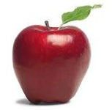
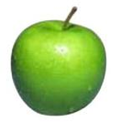
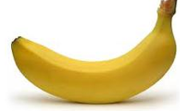
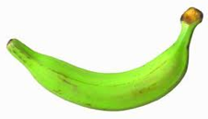
Data
examples
Data

Slide 20

Data
examples
Data

Slide 21

Data
examples
Data

Slide 22


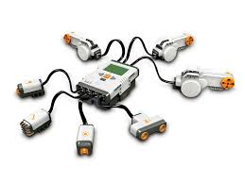
Data
examples
Data

Slide 23
Supervised learning
examples
label
label₁
label₃
labeled examples
label₄
label₅
Supervised learning: given labeled examples

Slide 24
Supervised learning
label
label₁
model/
predictor
label₃
label₄
label₅
Supervised learning: given labeled examples

Slide 25
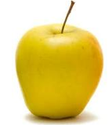
Supervised learning
model/
predictor
predicted label
Supervised learning: learn to predict new example

Slide 26
Supervised learning: classification
label
apple
Classification: a finite set of labels
apple
banana
banana
Supervised learning: given labeled examples

Slide 27
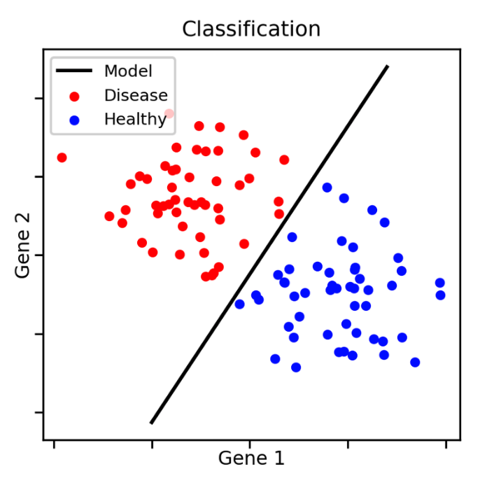
Classification Example

Slide 28
Classification Applications
Face recognition
Character recognition
Spam detection
Medical diagnosis: From symptoms to illnesses
Biometrics: Recognition/authentication using physical and/or behavioral characteristics: Face, iris, signature, etc
...

Slide 29
Supervised learning: regression
label
-4.5
Regression: label is real-valued
10.1
3.2
4.3
Supervised learning: given labeled examples

Slide 30
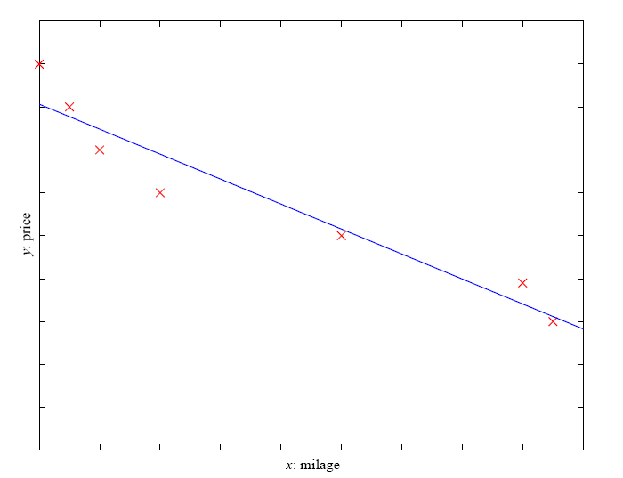
Regression Example
Price of a used car
x : car attributes (e.g. mileage)
y : price
y = wx+w₀

Slide 31
Regression Applications
Economics/Finance: predict the value of a stock
Epidemiology
Car/plane navigation: angle of the steering wheel, acceleration, …
Temporal trends: weather over time
…

Slide 32
Supervised learning: ranking
label
1
Ranking: label is a ranking
4
2
3
Supervised learning: given labeled examples

Slide 33
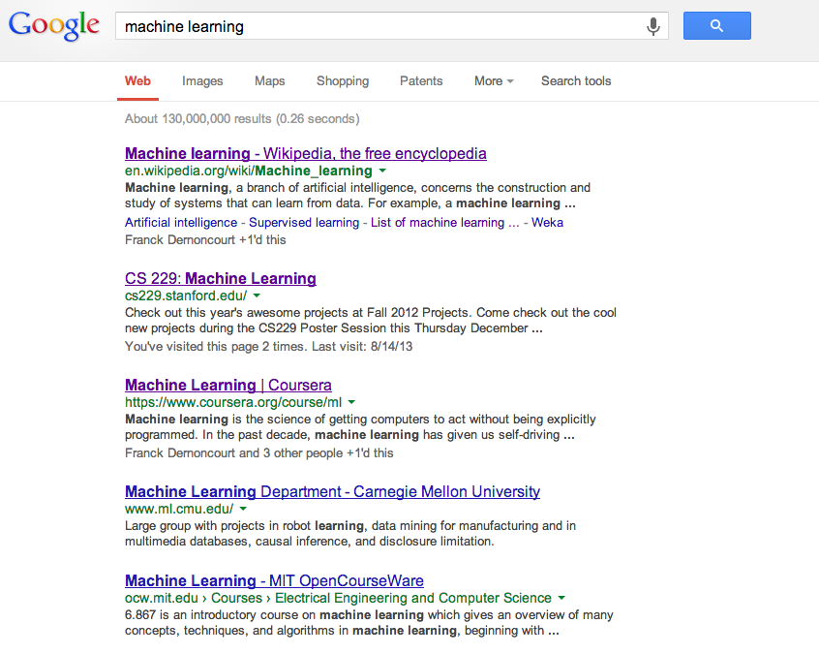
Ranking example
Given a query and
a set of web pages,
rank them according
to relevance

Slide 34
Ranking Applications
User preference, e.g. movie ranking
iTunes
flight search (search in general)
reranking N-best output lists
…

Slide 35
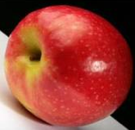
Unsupervised learning
Unupervised learning: given data, i.e. examples, but no labels

Slide 36
Unsupervised learning applications
learn clusters/groups without any label
customer segmentation (i.e. grouping)
image compression
bioinformatics: learn motifs
…

Slide 37
Reinforcement learning
left, right, straight, left, left, left, straight
GOOD
left, straight, straight, left, right, straight, straight
BAD
left, right, straight, left, left, left, straight
18.5
left, straight, straight, left, right, straight, straight
-3
Given a sequence of examples/states and a reward after completing that sequence, learn to predict the action to take for an individual example/state

Slide 38
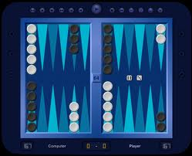
Reinforcement learning example
Backgammon
…
WIN!
…
LOSE!
Given sequences of moves and whether or not the player won at the end, learn to make good moves

Slide 39
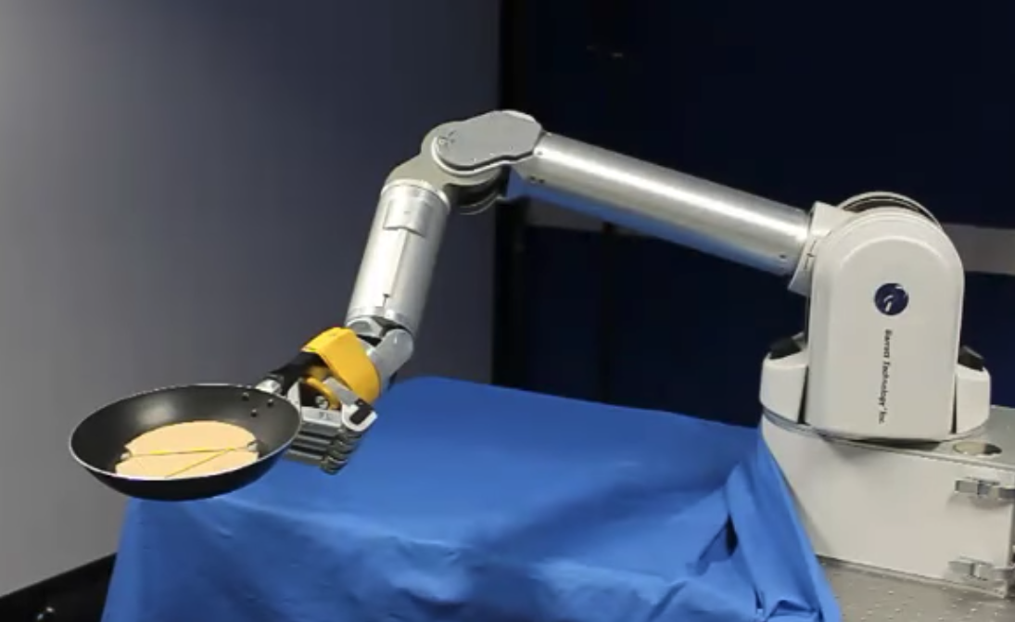
Reinforcement learning example
https://www.youtube.com/watch?v=W_gxLKSsSIE

Slide 40
Other learning variations
What data is available:
Supervised, unsupervised, reinforcement learning
semi-supervised, active learning, …
How are we getting the data:
online vs. offline learning
Type of model:
generative vs. discriminative
parametric vs. non-parametric

Slide 41
Representing examples
examples
What is an example?
How is it represented?

Slide 42
Features
examples
features
How our algorithms actually “view” the data
Features are the questions we can ask about the examples
f₁, f₂, f₃, …, f_{n}
f₁, f₂, f₃, …, f_{n}
f₁, f₂, f₃, …, f_{n}
f₁, f₂, f₃, …, f_{n}

Slide 43
Features
examples
features
How our algorithms actually “view” the data
Features are the questions we can ask about the examples
red, round, leaf, 3oz, …
green, round, no leaf, 4oz, …
yellow, curved, no leaf, 8oz, …
green, curved, no leaf, 7oz, …

Slide 44
Classification revisited
examples
label
red, round, leaf, 3oz, …
apple
learn
green, round, no leaf, 4oz, …
apple
model/
classifier
yellow, curved, no leaf, 8oz, …
banana
green, curved, no leaf, 7oz, …
banana
During learning/training/induction, learn a model of what distinguishes apples and bananas based on the features

Slide 45
Classification revisited
predict
Apple or banana?
model/
classifier
red, round, no leaf, 4oz, …
The model can then classify a new example based on the features

Slide 46
Classification revisited
predict
model/
classifier
Apple
red, round, no leaf, 4oz, …
Why?
The model can then classify a new example based on the features

Slide 47
Classification revisited
Training data
Test set
examples
label
red, round, leaf, 3oz, …
apple
?
green, round, no leaf, 4oz, …
apple
red, round, no leaf, 4oz, …
yellow, curved, no leaf, 4oz, …
banana
green, curved, no leaf, 5oz, …
banana

Slide 48
Classification revisited
Training data
Test set
examples
label
red, round, leaf, 3oz, …
apple
?
green, round, no leaf, 4oz, …
apple
red, round, no leaf, 4oz, …
yellow, curved, no leaf, 4oz, …
banana
Learning is about generalizing from the training data
green, curved, no leaf, 5oz, …
banana
What does this assume about the training and test set?

Slide 49
Past predicts future
Training data
Test set

Slide 50
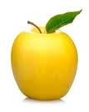
Past predicts future
Training data
Test set
Not always the case, but we’ll often assume it is!

Slide 51
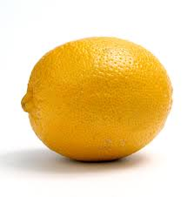
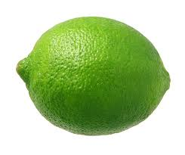
Past predicts future
Training data
Test set
Not always the case, but we’ll often assume it is!

Slide 52
More technically…
We are going to use the probabilistic model of learning
There is some probability distribution over example/label pairs called the data generating distribution
Both the training data and the test set are generated based on this distribution
What is a probability distribution?

Slide 53
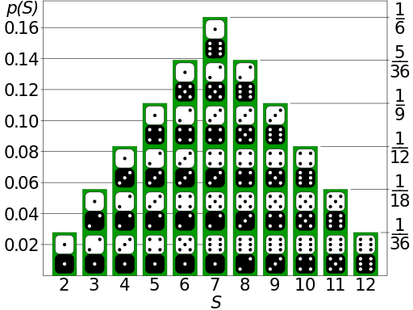
Probability distribution
Describes how likely (i.e. probable) certain events are
Describes probabilities for all possible events
Probabilities are between 0 and 1 (inclusive)
Sum of probabilities over all events is 1

Slide 54
Probability distribution
Training data
High probability
Low probability
round apples
curved bananas
apples with leaves
…
curved apples
red bananas
yellow apples
…

Slide 55
data generating distribution
Training data
Test set
data generating distribution

Slide 56
data generating distribution
Training data
Test set
data generating distribution

Slide 57
data generating distribution
Training data
Test set
data generating distribution

